Slide 1
Ransomware
Modern Crime and Society

Slide 2
Encryption
We remember what encryption is . . .
Process of turning readable data into code to prevent unauthorized access
Normally, encryption is used to protect data from some malicious outsider or attacker
If I don’t want someone to read my data, I can encrypt it so they can’t read it without the key
CF: If I want to protect my computer from hacking I will use some sort of security software, such as a firewall or password protection, etc.

Slide 3
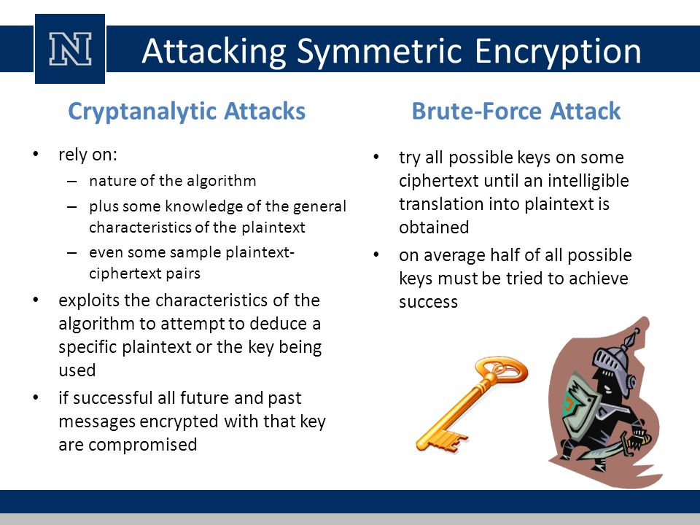

Slide 4
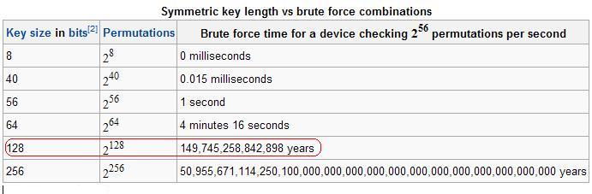

Slide 5
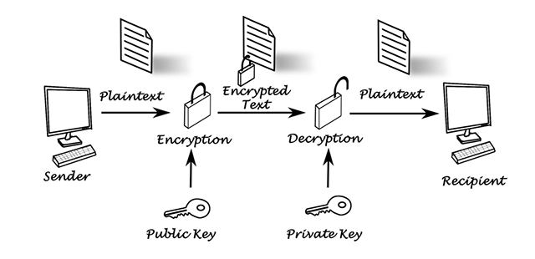

Slide 6
Extortion
What is the definition of extortion?
Simple definition: the crime of getting money from someone by the use of force or threats
The “threat of force” is not one of imminent physical danger to the victim.
An example of extortion is the “protection” scheme where the criminal demands that shop owners pay for their protection to prevent something bad from happening.
Blackmail Making
False accusation

Slide 7
Kidnapping
Kidnapping Definition:
The unlawful carrying away and confinement of another person by force, typically to obtain ransom

Slide 8
Encryption + Extortion + Kidnapping = Ransomware
Ransomware is a type of malware (malicious computer program, such as virus, worm, etc)
The purpose of ransomware is to extort money from the victim by demanding a ransom.
How does it extort money?
By holding the victim’s data hostage.
How does it hold a victim’s data hostage?
By taking the data and encrypting it.

Slide 9
Ransomware - Steps
Infect a computer device with the malware software
The malware encrypts the computer’s data
Demand payment within a limited timeframe:
If the user does not pay, the encryption key is destroyed (and the data is irrevocably lost)
If the user does pay, gives the user the encryption key

Slide 10
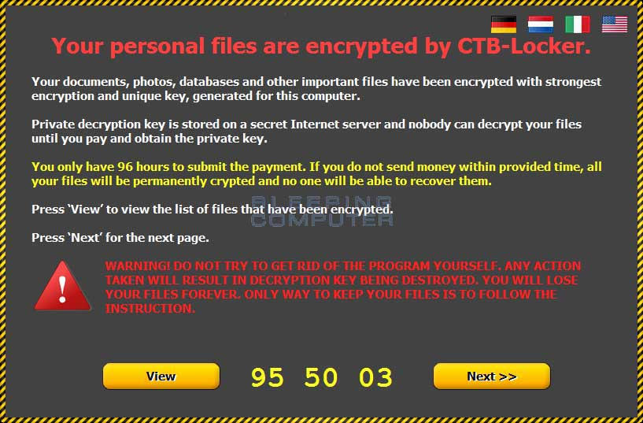

Slide 11
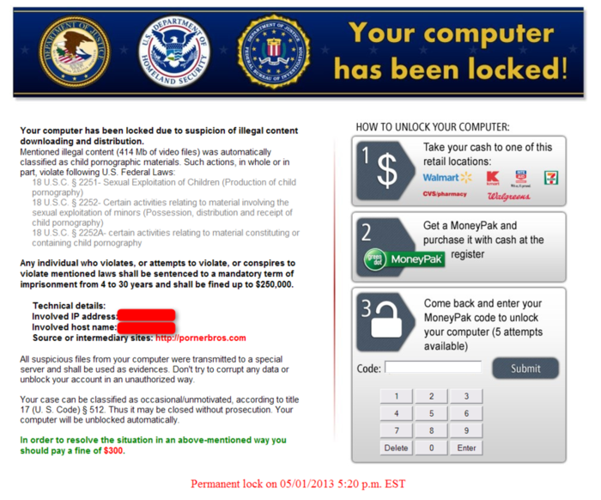

Slide 12

Ransomware
The first known instance of ransomware was in 1989
However, in recent years ransomware has become a more popular form of criminal attack. Why?
BITCOIN
Up to 40 percent of malware is
now ransomware
93 Percent of Phishing spam

Slide 13
Ransomware and Bitcoin
Problem – You are a hacker who wants to get paid.
But that payment can be traced by authorities.
How can you do it?
Enter BITCOIN
Bitcoin is a “crypto-currency”
A cryptocurrency (or crypto currency) is a medium of exchange using cryptography to secure the transactions and to control the creation of new units.
For a criminal, bitcoin has substantial advantages:
No need to use a bank/enter the financial system
Anonymous/Pseudo-anonymous
Decentralized
Transactions are irrevocable

Slide 14
Ransomware – Wanna Cry
On May 11, 2017, a significant ransware attack occurred globally.
The name of the Ransomware was “Wanna Cry”
WannaCry operated similar to a worm rather than traditional malware
I.e. it self-replicated across systems.
It did so by utilizing software developed created by and OS exploits used by the NSA and leaked earlier this year (code name Eternal Blue).
Possibly up to 200,000 computer systems across more than 70 countries

Slide 15
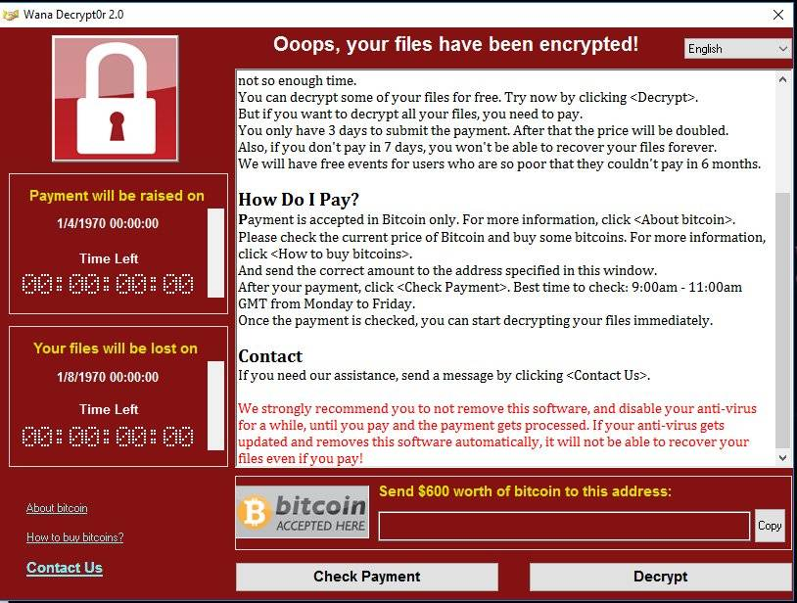

Slide 16
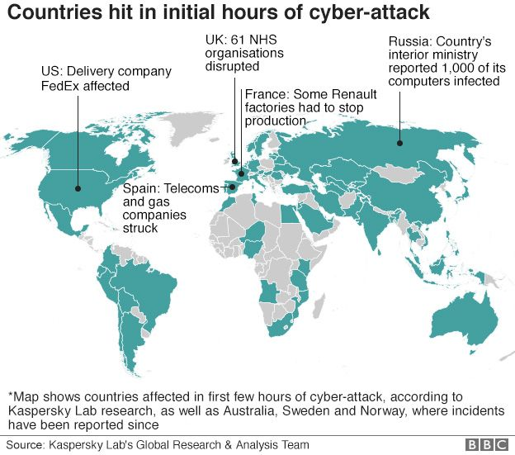
Ransomware – WannaCry

Slide 17
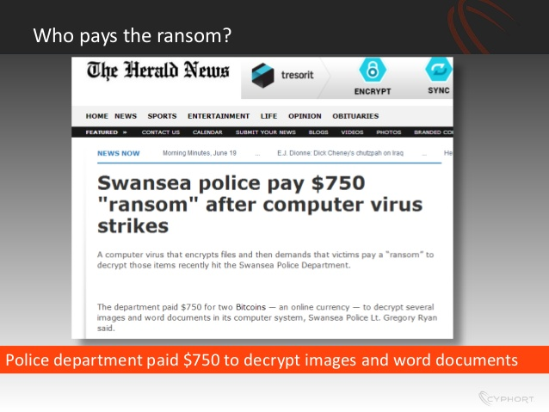

Slide 18
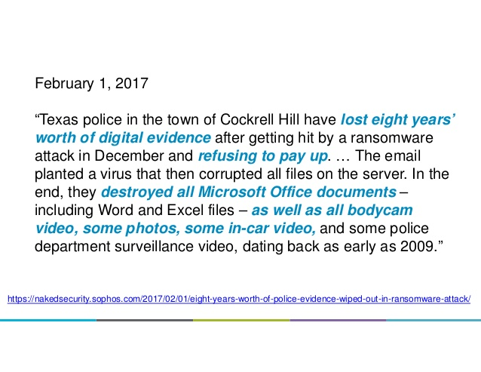

Slide 19
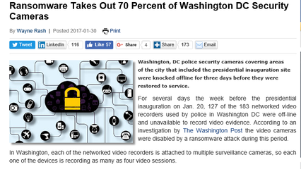

Slide 20
Atlanta
March 22 – Ransomware “Samsam” attacked the city government’s computers
Computer systems were down for five days (Some files still unaccessible):
People could not pay utilities
Parking fines could not be paid
Hackers demanded 6 bitcoins in ransom (about $50,000)
City spent $2.7 Million to fix the computers

Slide 21

Ransomware – Internet of Things

Slide 22
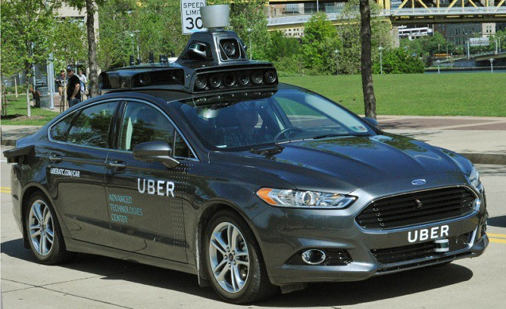

Slide 23


Slide 24
